Slide 1
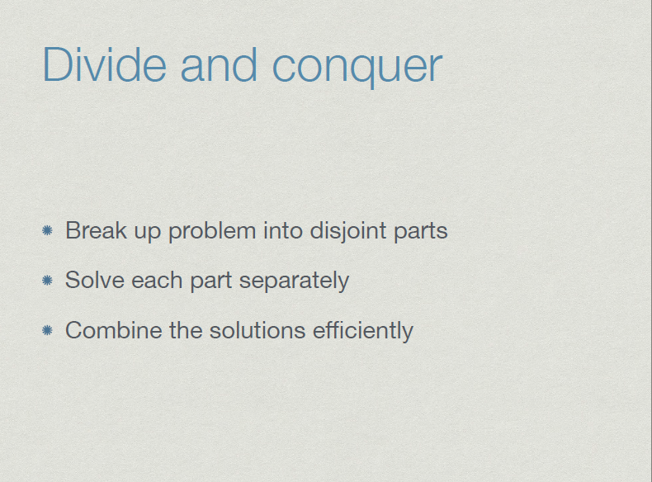


Slide 2
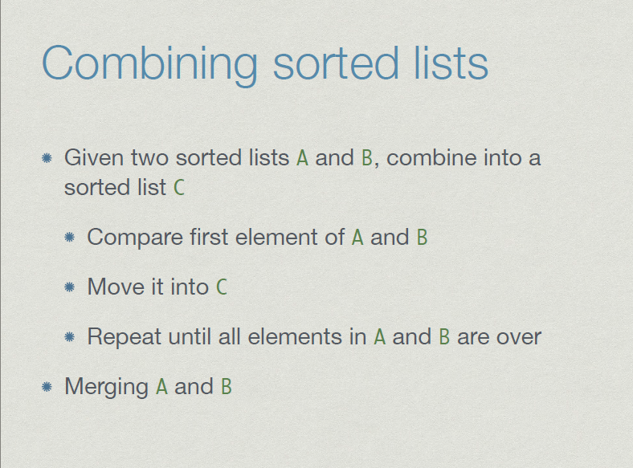

Slide 3
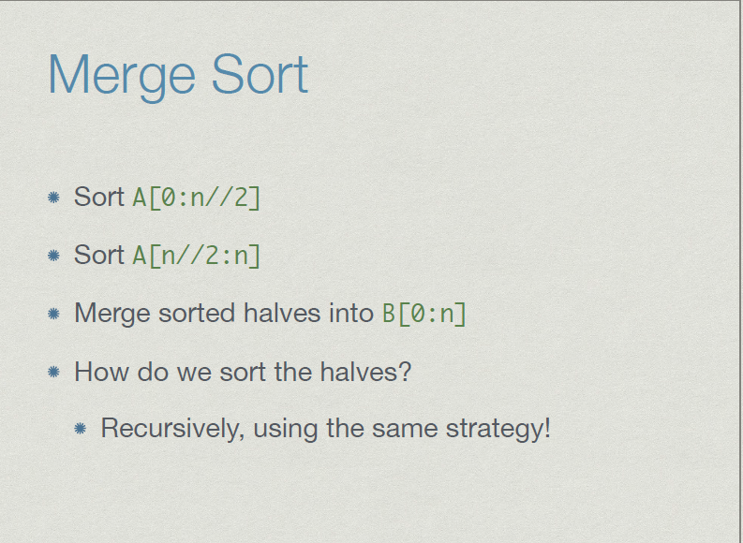

Slide 4
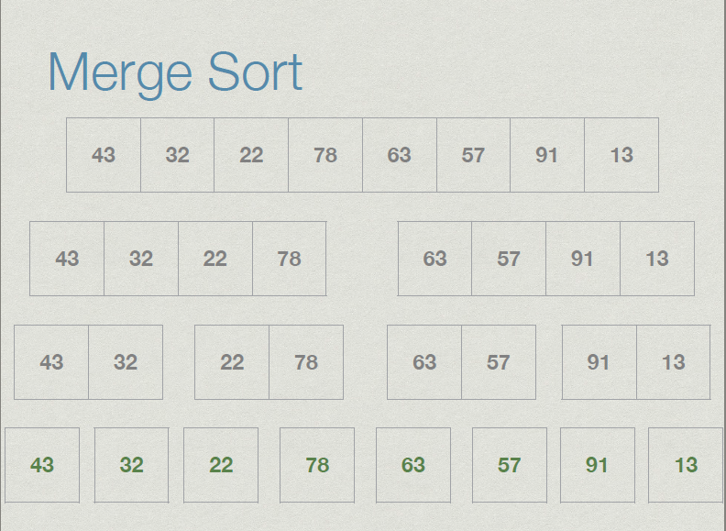

Slide 5
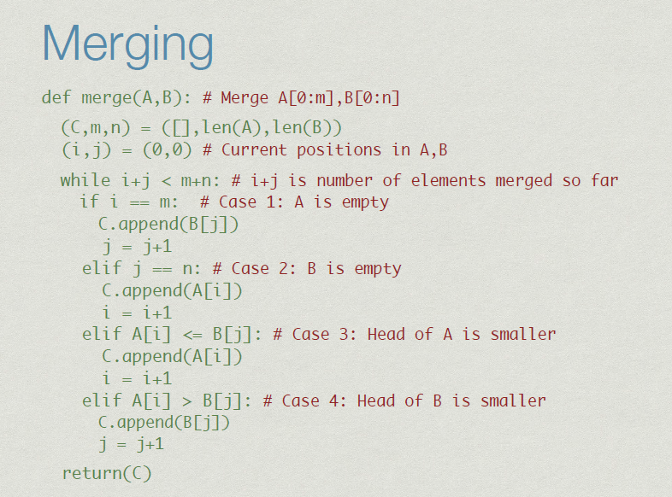

Slide 6
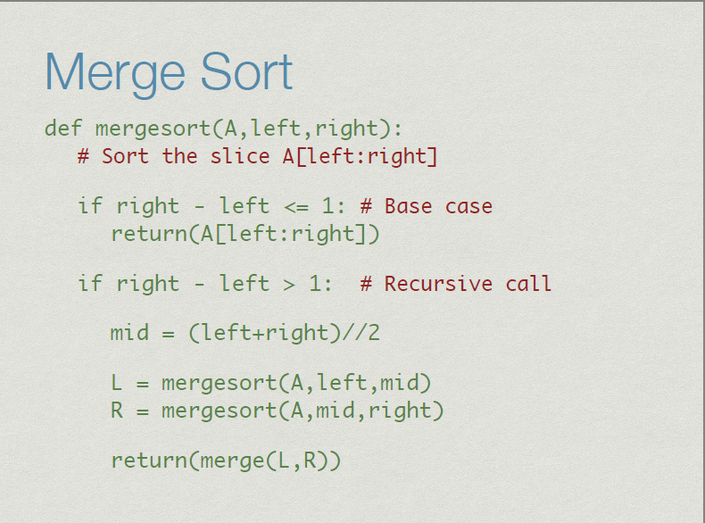

Slide 7
def merge(a,b):
c = []
while len(a) != 0 and len(b) != 0:
if a[0] < b[0]:
c.append(a[0])
a.remove(a[0])
else:
c.append(b[0])
b.remove(b[0])
if len(a) == 0:
c += b
else:
c += a
return c
def mergesort(x):
if len(x) == 0 or len(x) == 1:
return x
else:
middle = len(x)/2
a = mergesort(x[:middle])
b = mergesort(x[middle:])
return merge(a,b)
a=[1,2,4,5,3,6,7,8,10,9]
print (mergesort(a))

Slide 8
Binary Search
def binarysearch(list1,item):
list1copy=sorted(list1)
n=len(list1copy)
beg=0
end=n-1
mid=int((beg+end)/2)
while beg<=end:
if list1copy[mid]==item:
print ("Element found at posistion ", mid+1)
return
elif list1copy[mid]>item:
end=mid-1
mid=int((beg+end)/2)
else:
beg=mid+1
mid=int((beg+end)/2)
print ("Element not found”)
list1=[1,3,4,2,5,6,9,8,7]
item=7
binarysearch(list1,item)

Slide 9
Binary search cont…
n=int(input("enter no. of elements. "))
list1=[0]*n
for i in range(n):
list1[i]=int(input("Enter %d element: "%i))
item=int(input("Enter element to search: "))
binarysearch(list1,item)

Slide 10
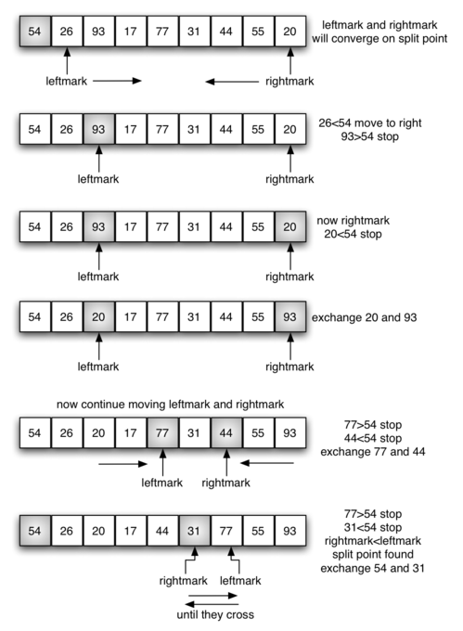
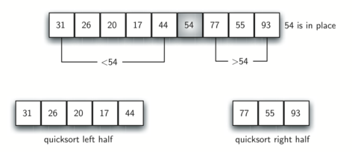
Quick Sort

Slide 11
def partition(lst,low,high):
i = ( low-1 )
pivot = lst[high]
for j in range(low , high):
if lst[j] <= pivot:
i = i+1
lst[i],lst[j] = lst[j],lst[i]
lst[i+1],lst[high] = lst[high],lst[i+1]
return ( i+1 )
def quickSort(lst,low,high):
if low < high:
pi = partition(lst,low,high)
quickSort(lst, low, pi-1)
quickSort(lst, pi+1, high)
a=[]
b=int(input("enter no of elements"))
for i in range(b):
c=int(input("enter number one by one"))
a.append(c)
n = len(a)
quickSort(a,0,n-1)
print ("Sorted lstay is:")
for i in range(n):
print (("%d " %a[i]),end= " ")

